Slide 1


First Principles and Machine Learning Investigations into the Atomic and Mechanical Properties of Cement Hydrates
Author:
Gabriel Balarezo
Advisor:
Henry Pinto, Ph.D.
Thesis Dissertation Defense
Insert a date

Slide 2
Contents
Introduction
Background
Methodology
Results
Discussion
Conclusions
Bibliography

Slide 3
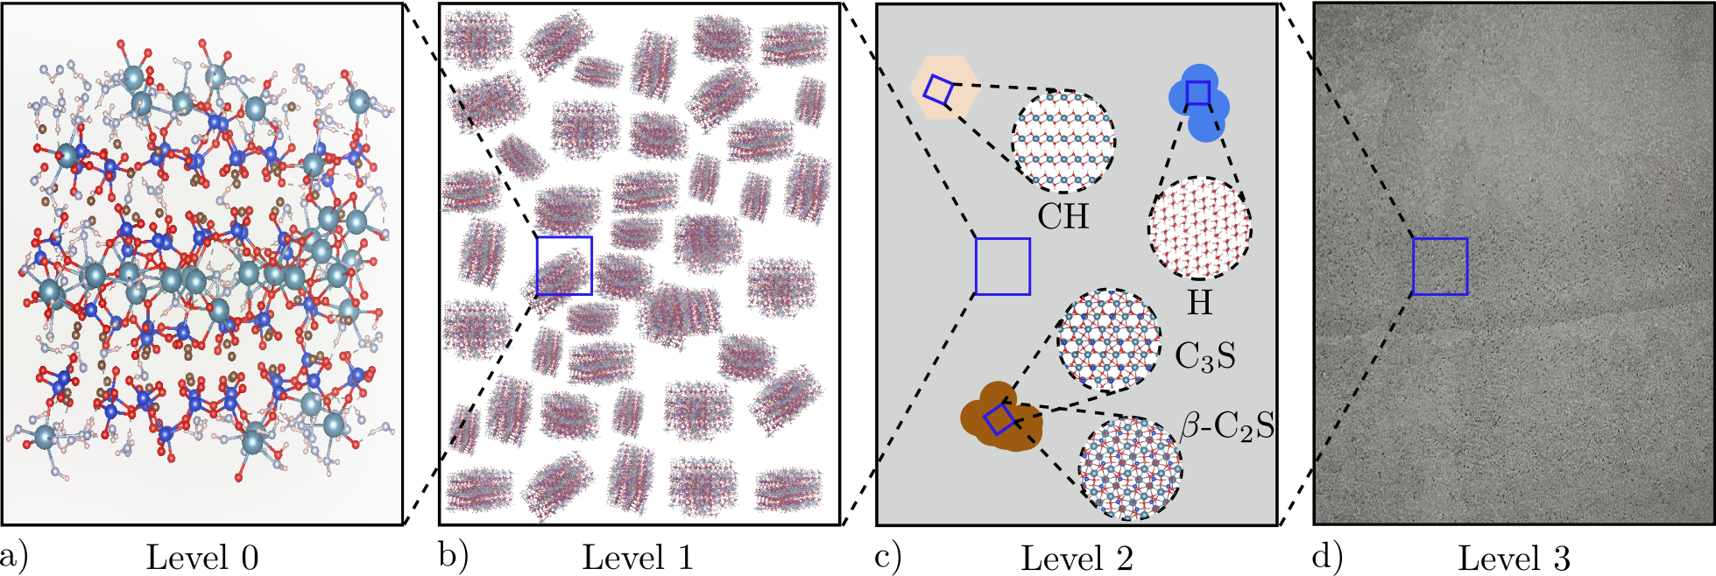
Introduction

Slide 4
Background

Slide 5
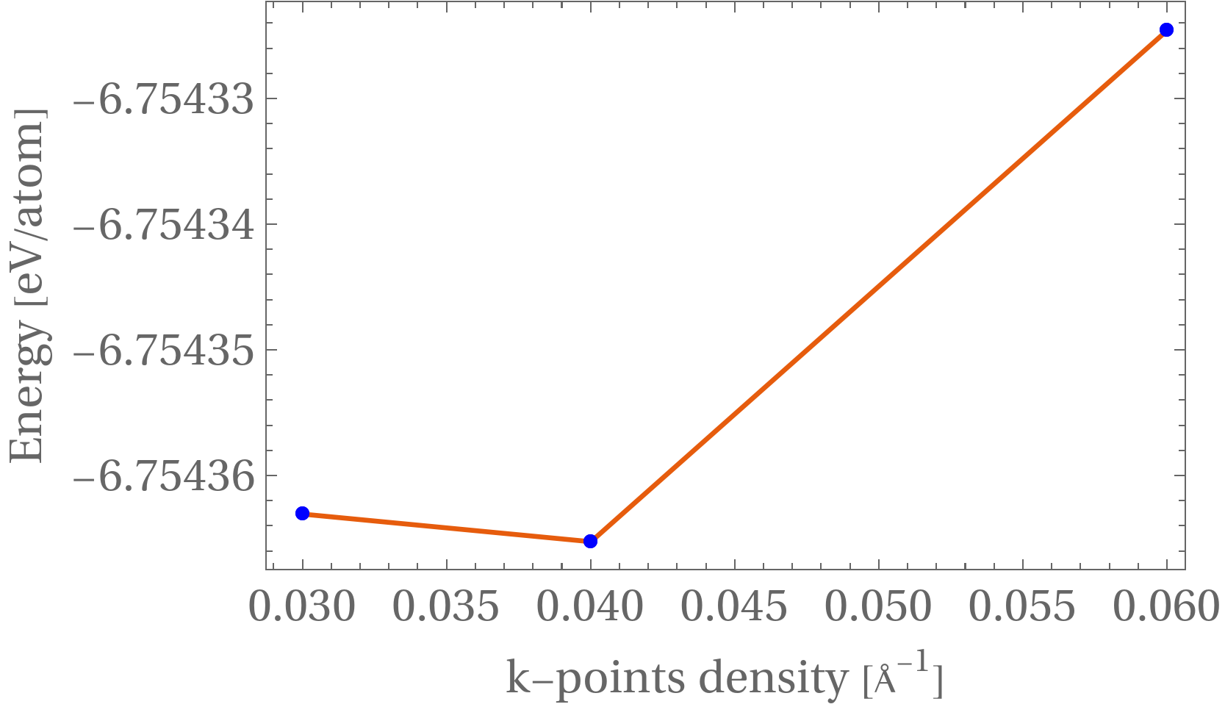
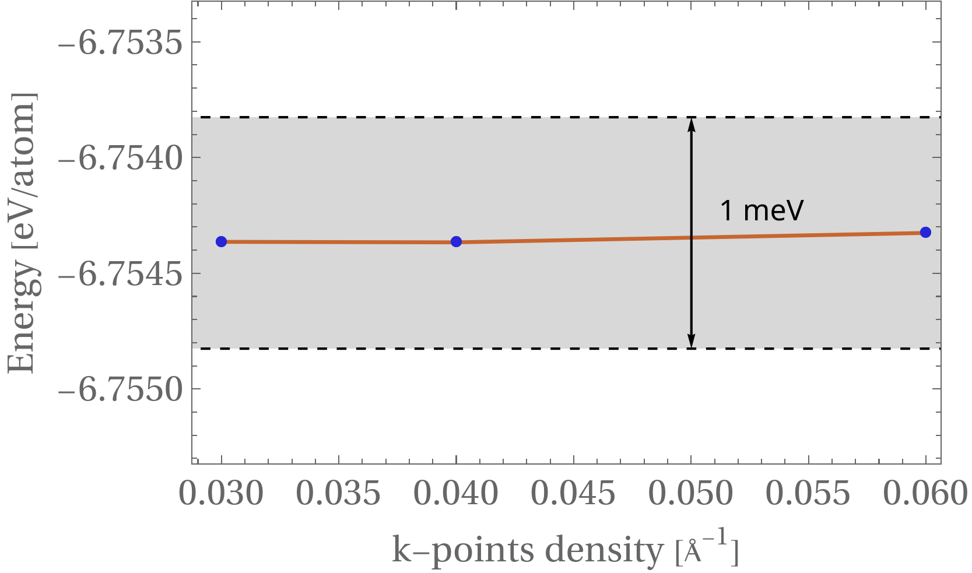
K-points convergency (DFTB+) afte
Methodology
Apply the 1meV criteria and test convergency.
We will use a k-point density grid of 0.06 for future calculations.

Slide 6
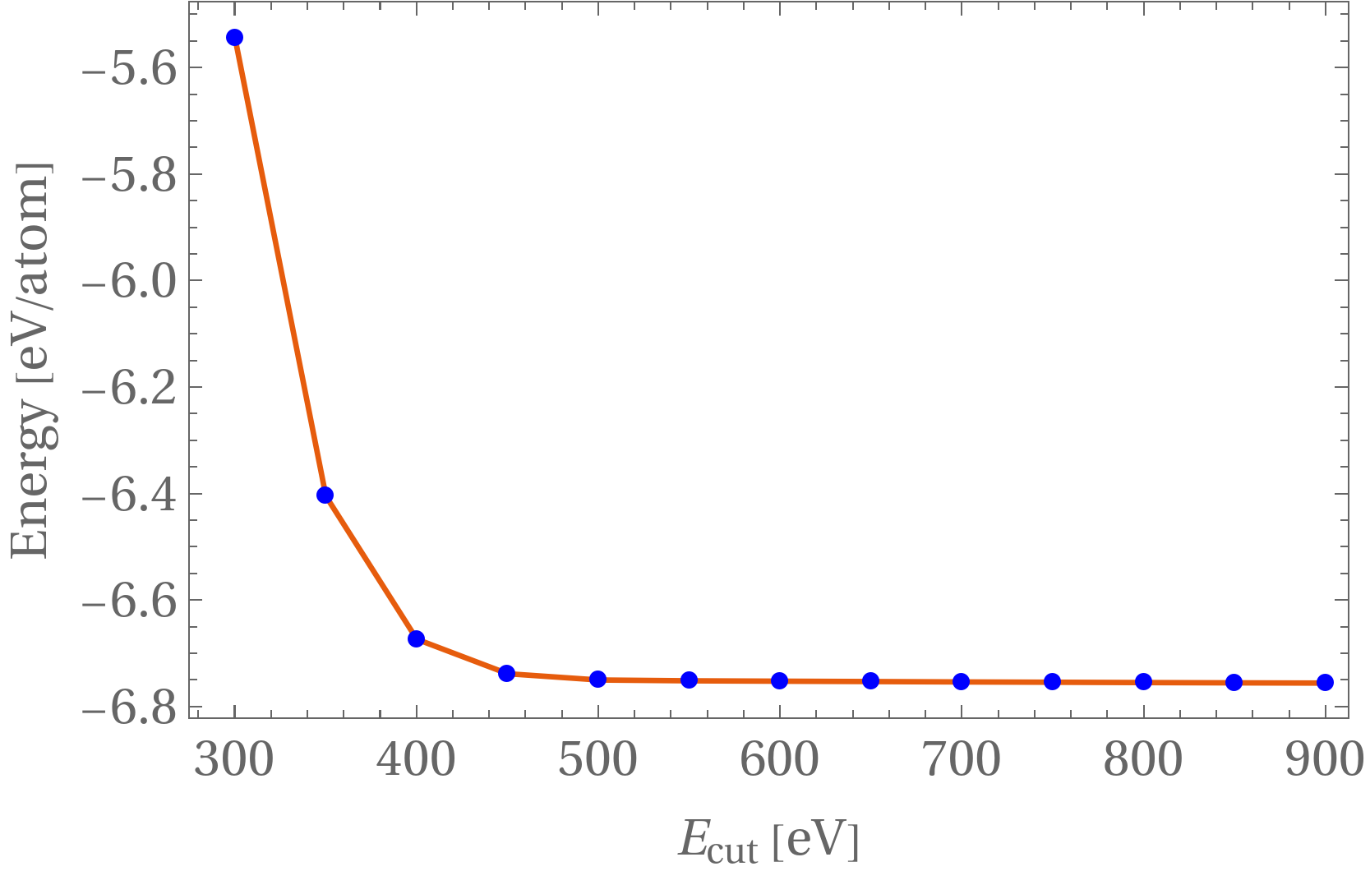
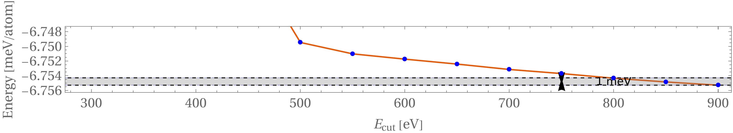
Cut-off energy convergency (VASP)
Methodology
Cut-off energy was sampled from 300-900 eV
Based on the results, we can assume convergency starting from 800 eV. Thereby, we will use this value for the k-points calculation.

Slide 7
K-points convergency (VASP)
Methodology

Slide 8
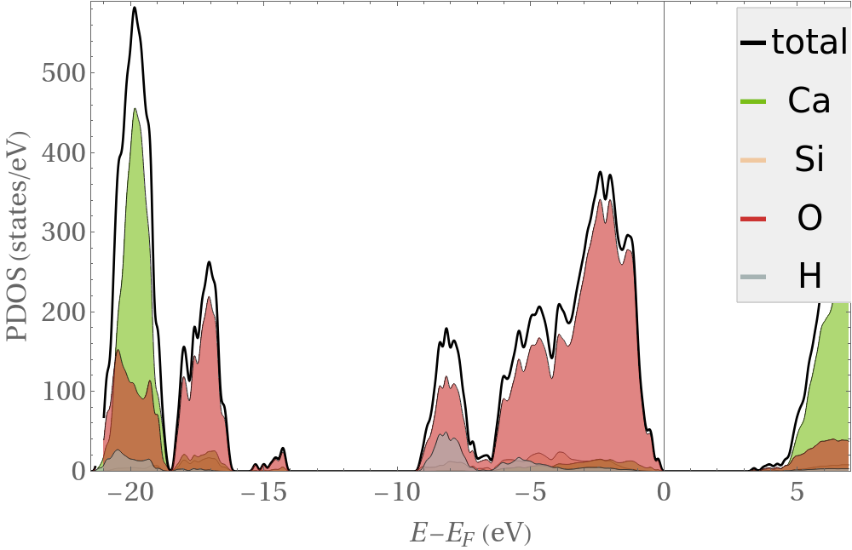
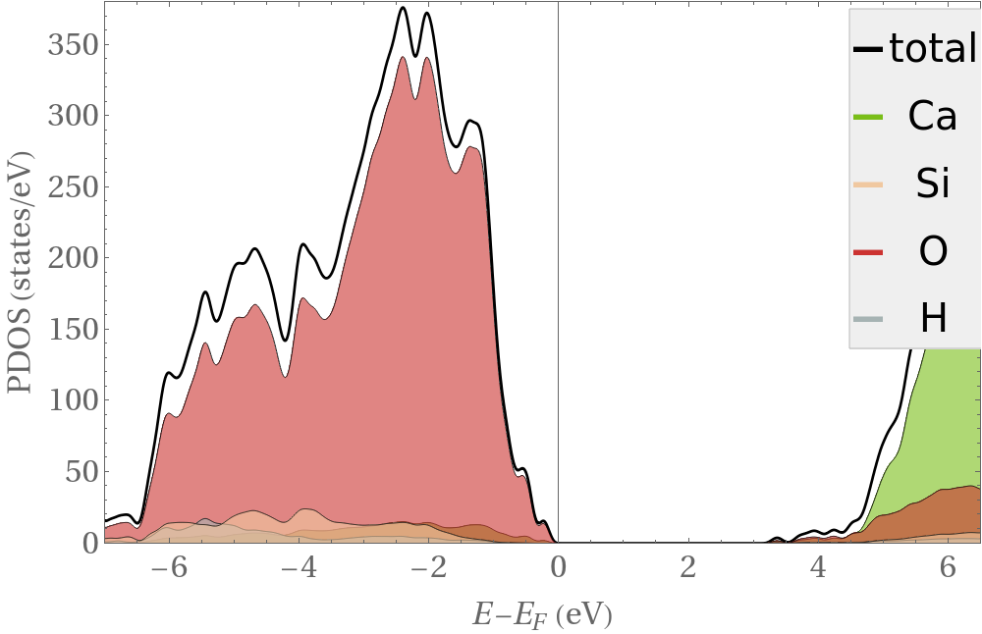
PDOS & DOS
Methodology
We have computed the partial and total DOS.
Ca contributes mostly equally to the conduction and valence band.
O contribution is mostly located on the valence band, but it also contributes in small amount to the conduction band.
H & Si contributions are very small, and they mostly contribute the valence band.
CSH has a band gap of around 3.4 meV.

Slide 9
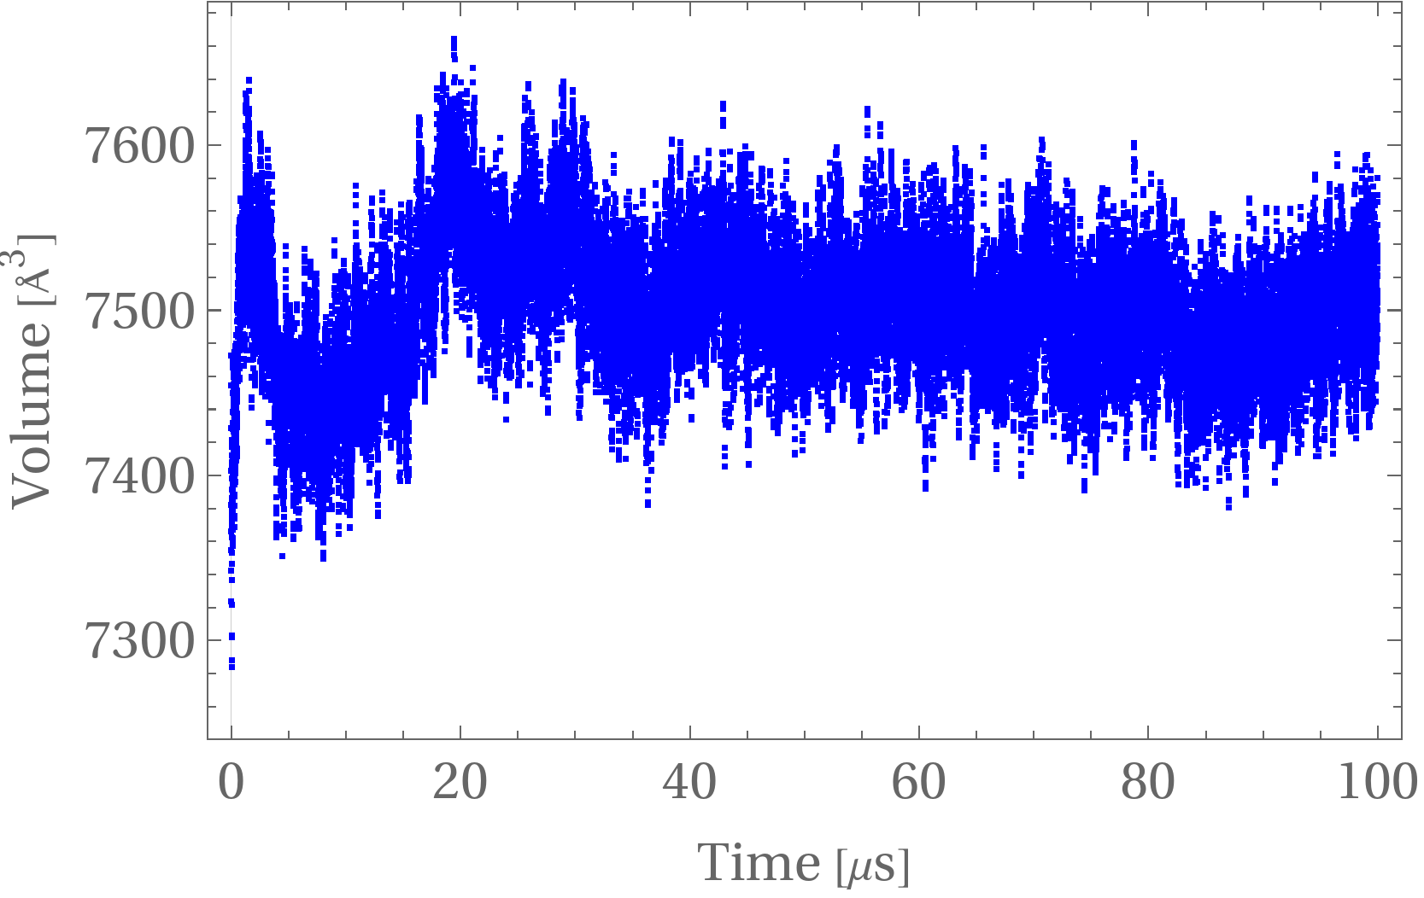
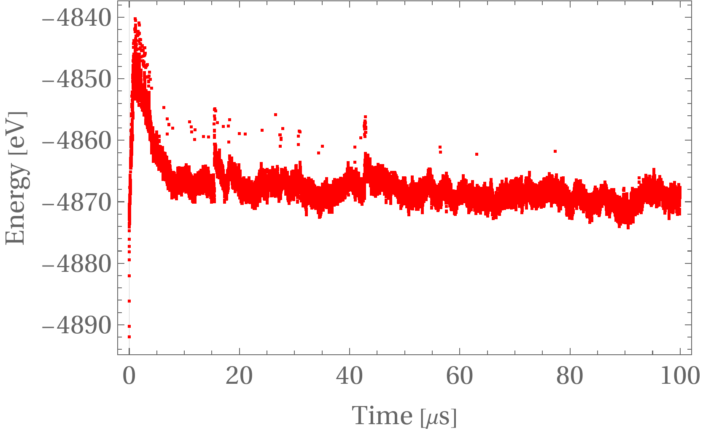
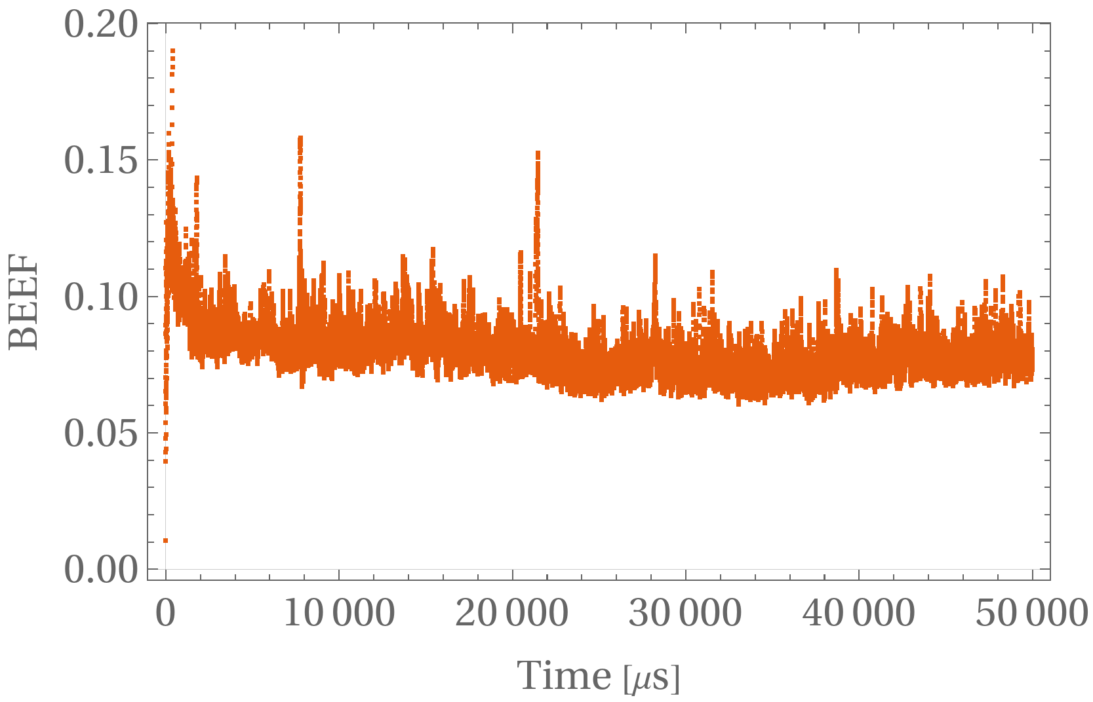
Molecular dynamics & MLFF training
Methodology
Volume error is in the order of 2% of the total volume.
Energy and BEEF seem to reach a steady state, some spikes may be related to training phases.

Slide 10
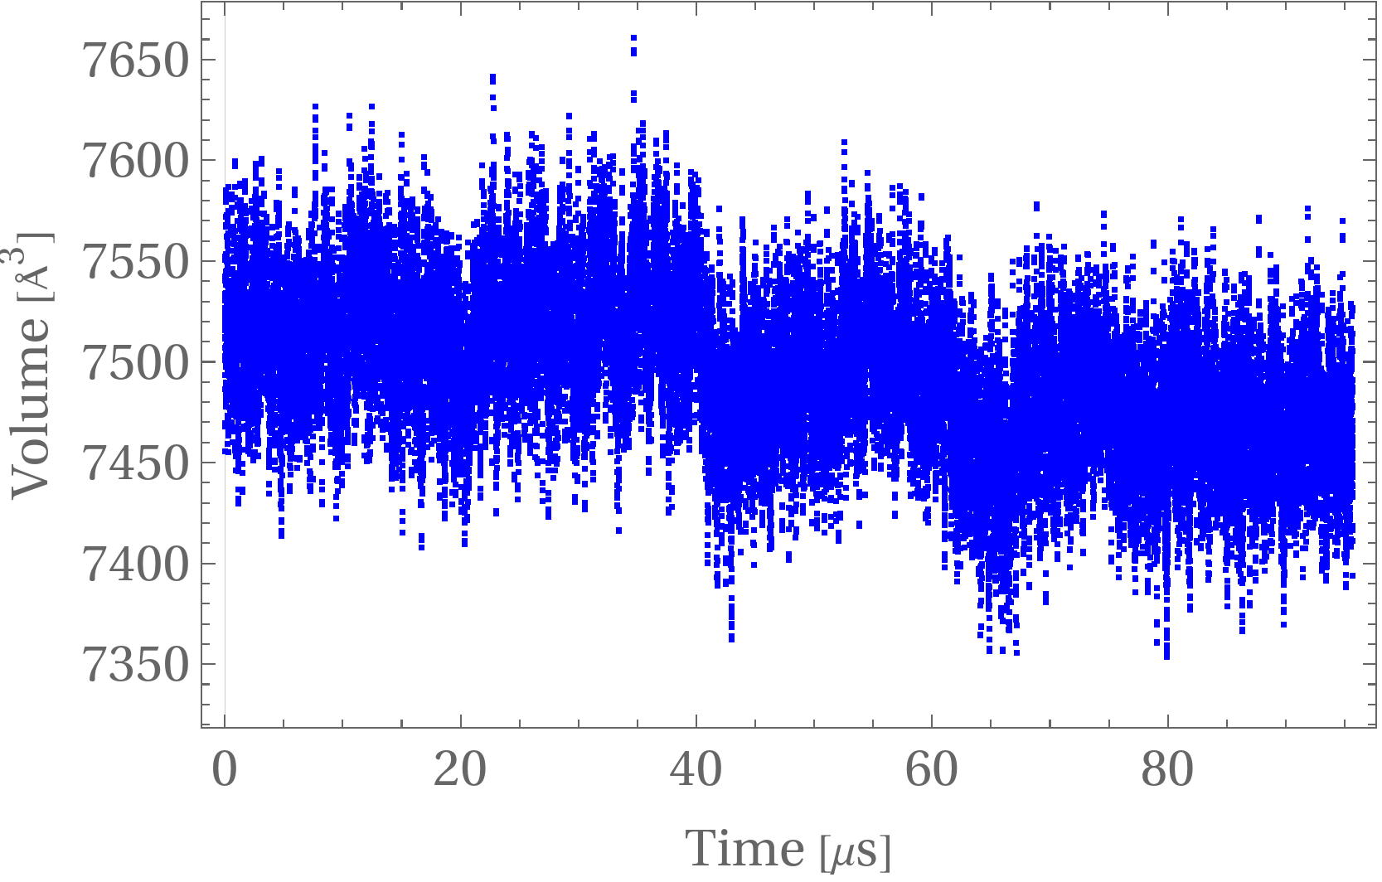
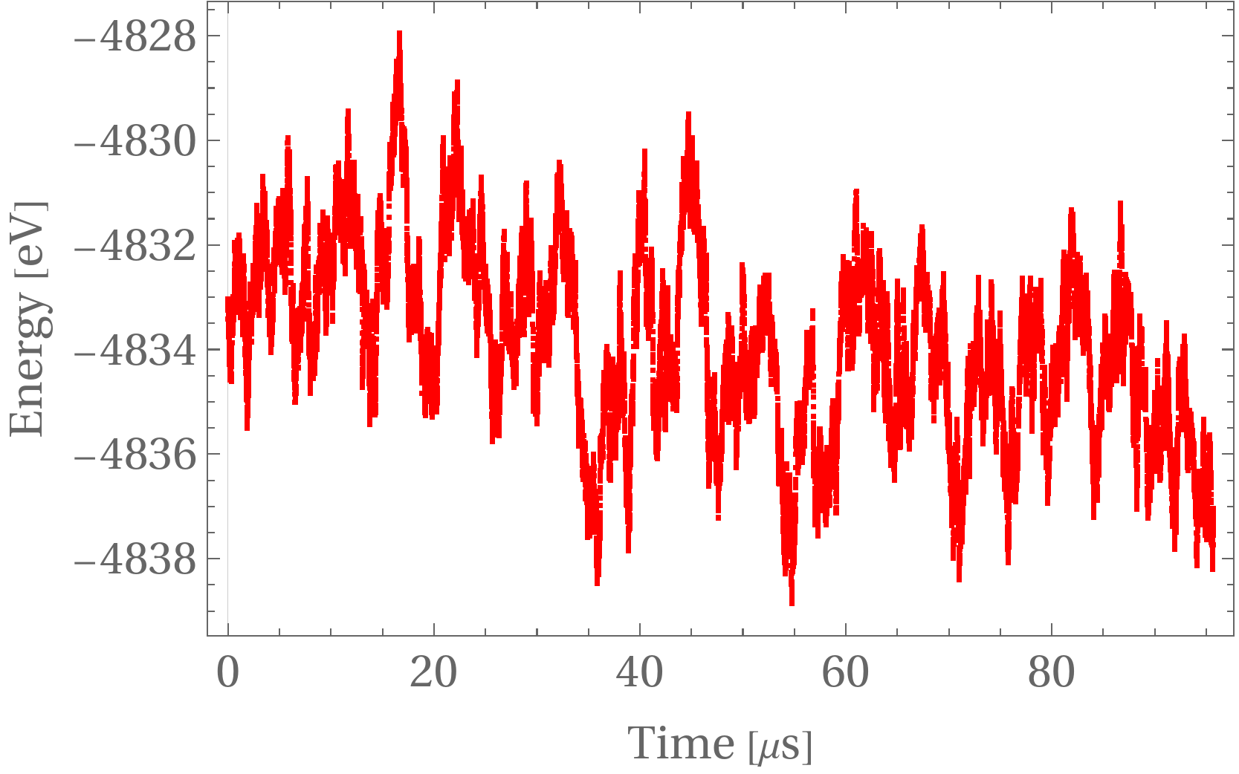
MLFF prediction
Methodology
Volume error is in the same order as before, which is good news.
Energy seems to have some upwads and downwards spikes, nevertheless, the errors is still bounded and acceptable.

Slide 11
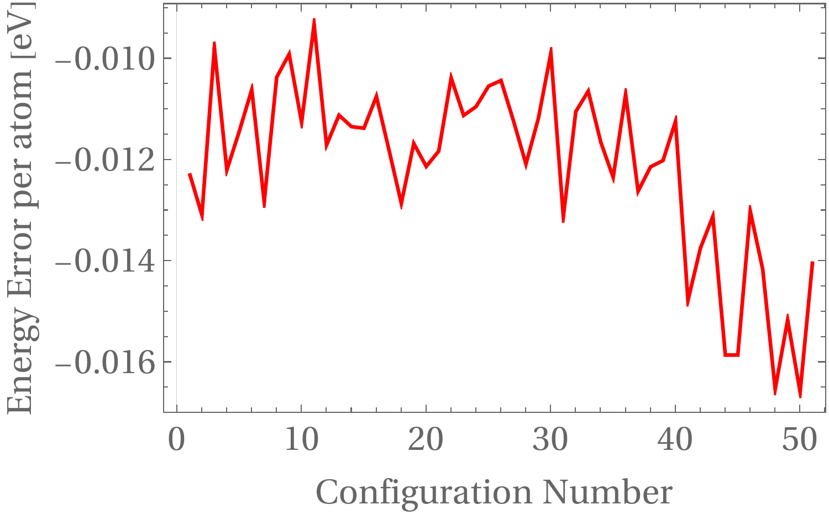
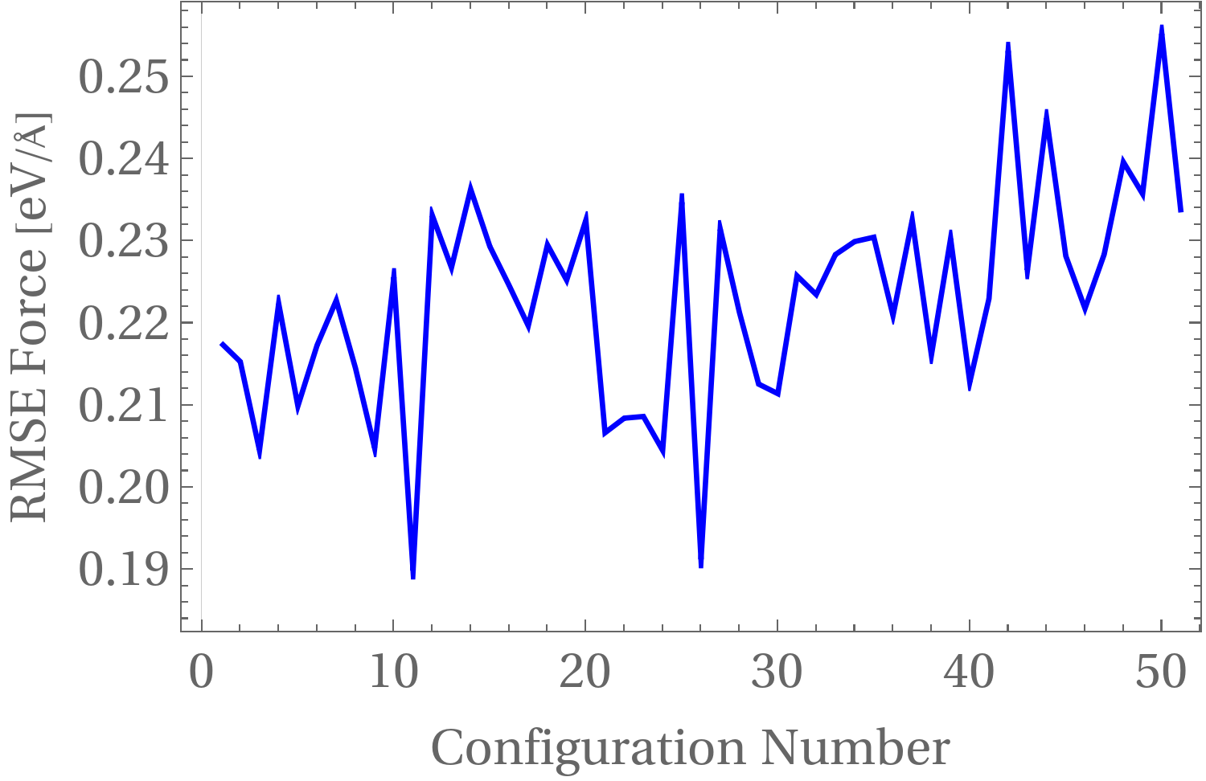
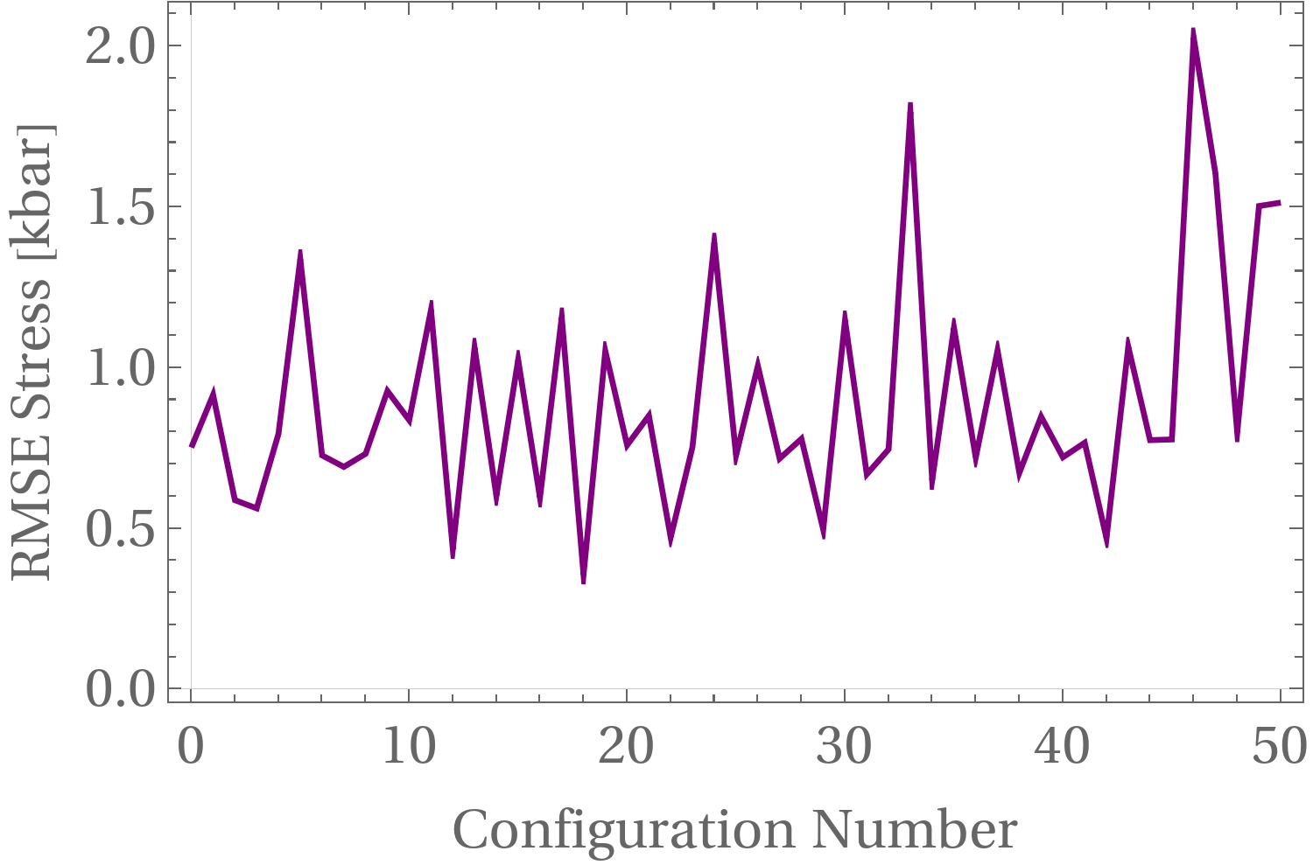
Prediction error analysis
Methodology
We took 51 structures and relaxed each one of them using DFT and our MLFF separately.

Slide 12
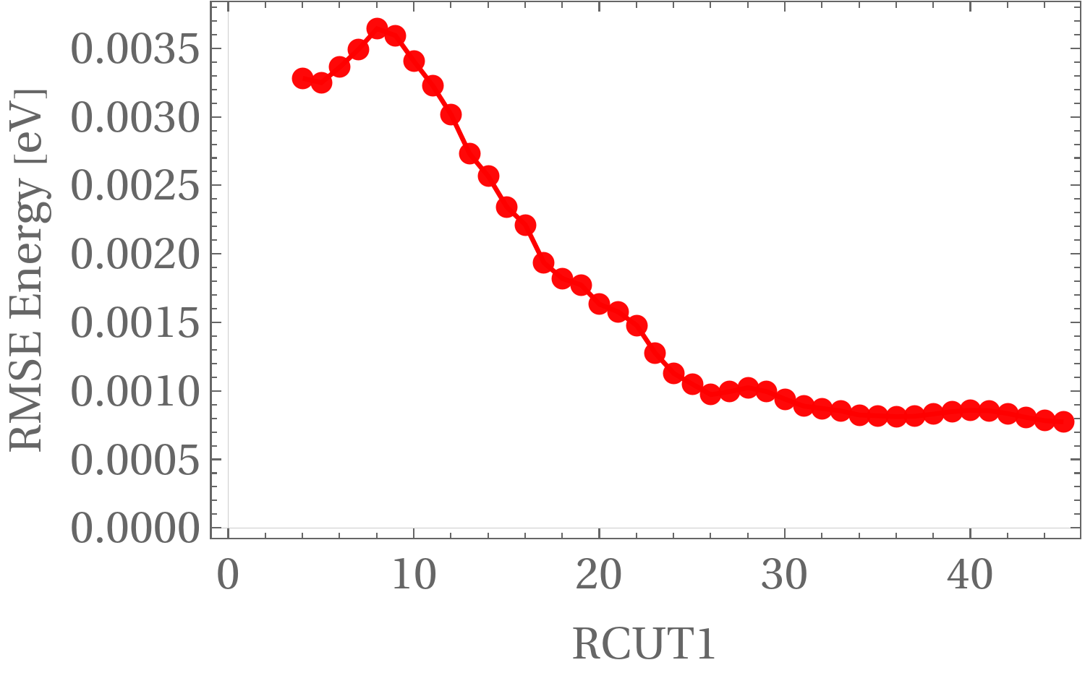
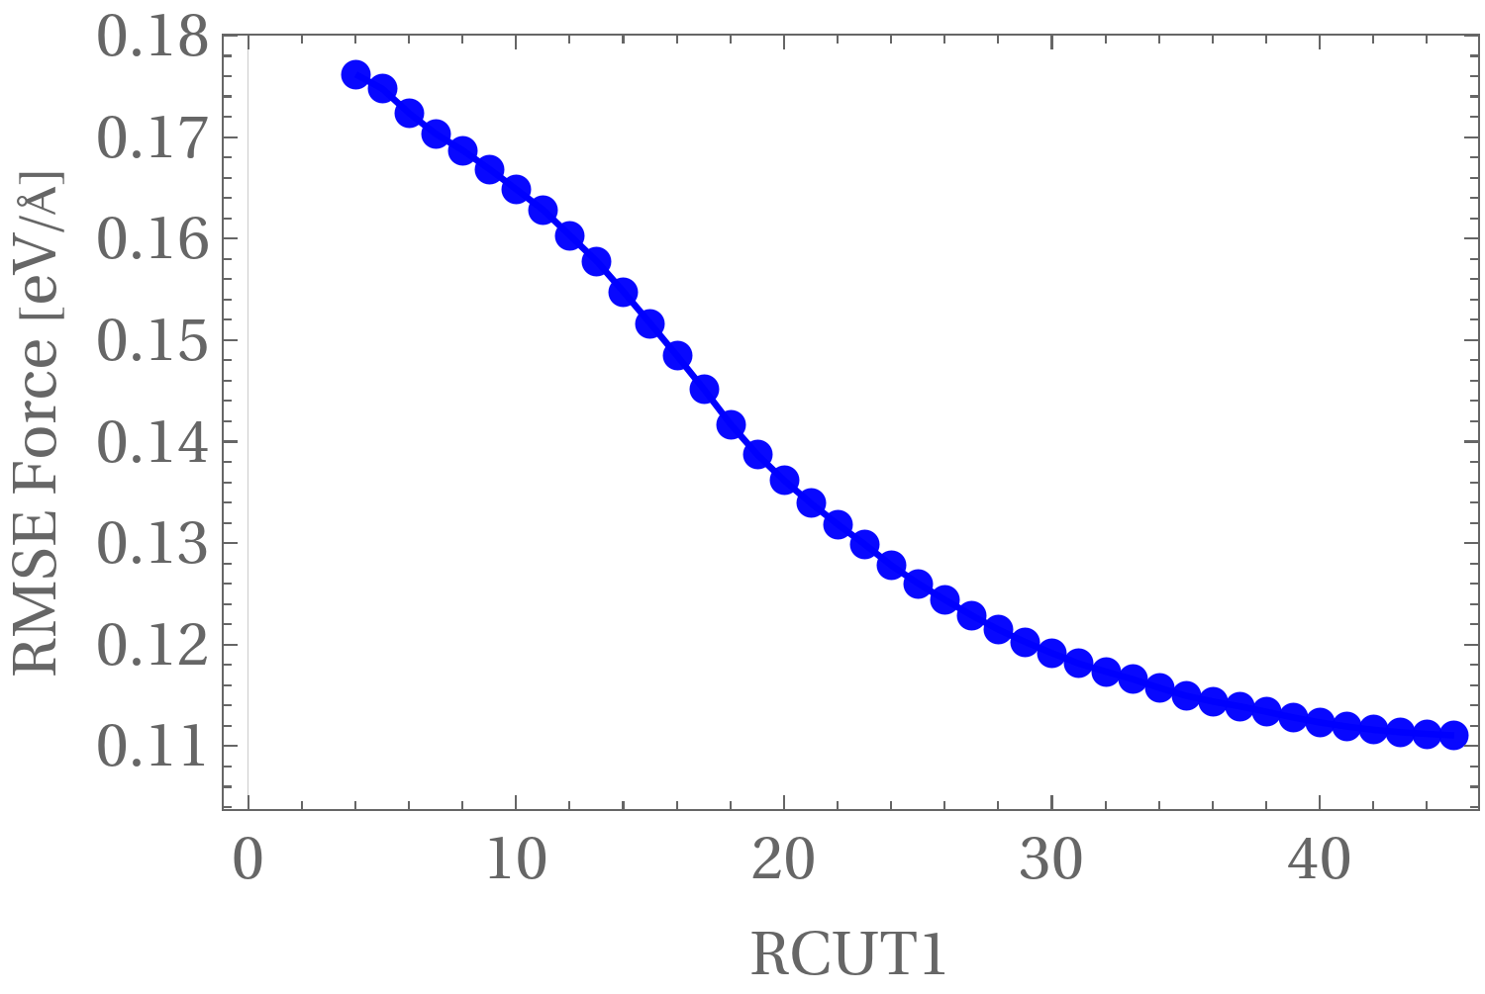
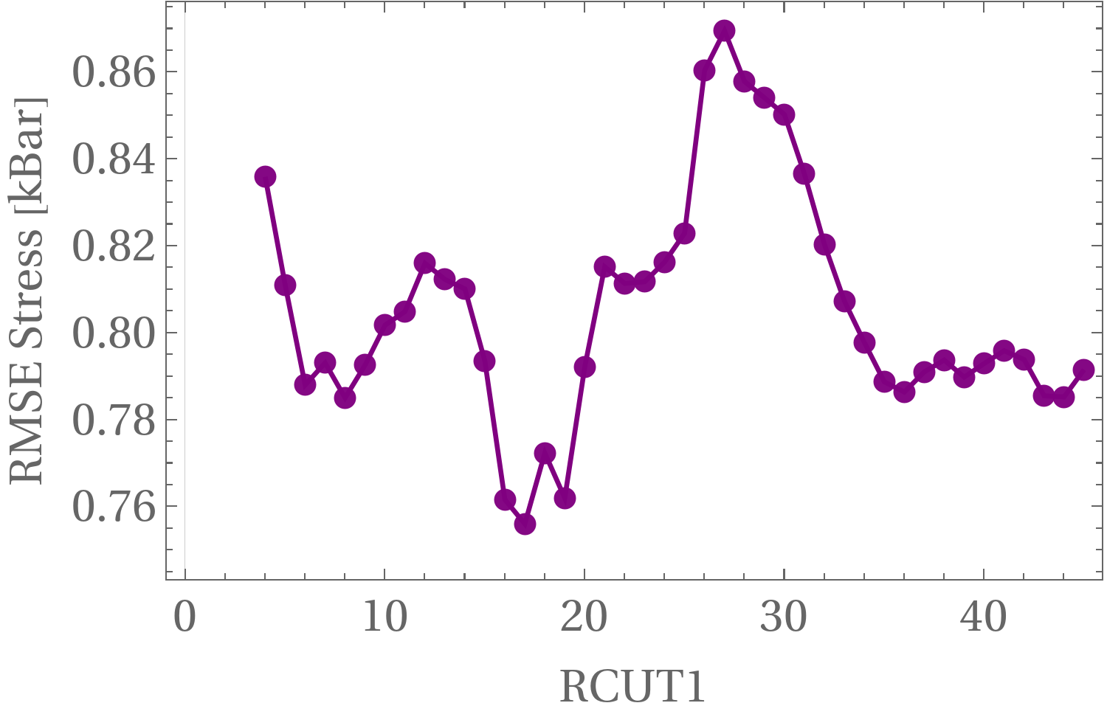
Reffiting our MLFF: RCUT1
Methodology
RCUT1 does not provide a clear and acceptable minimum for RMSE Energy & Force.
On the other hand, RMSE Stress provide a clear minimum.

Slide 13
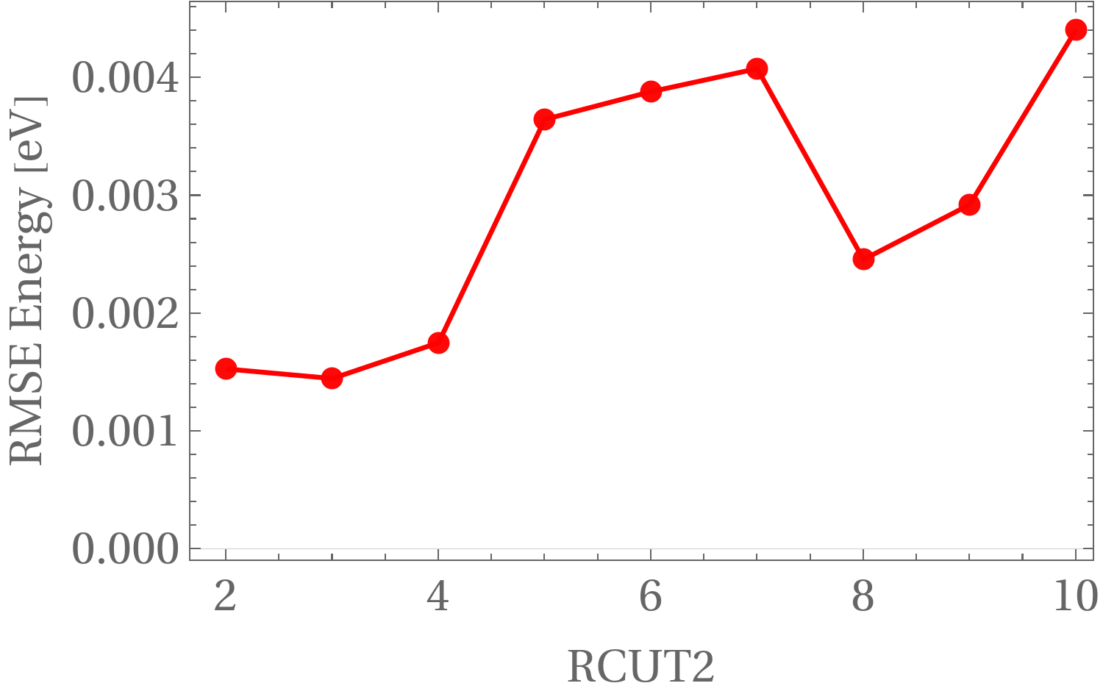
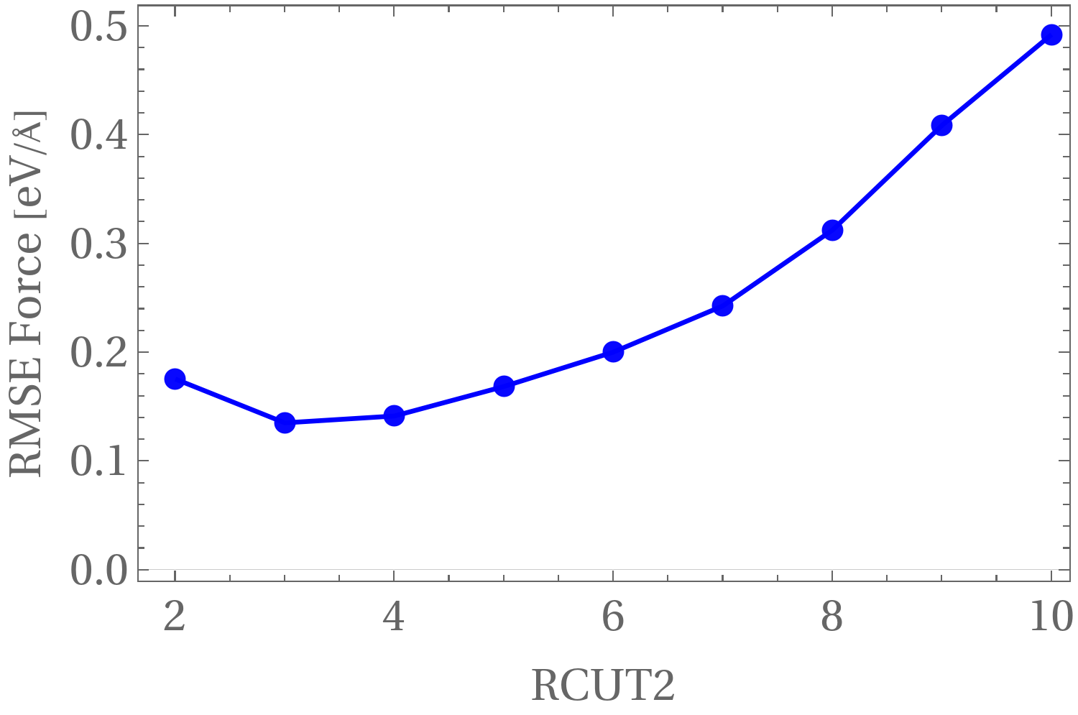
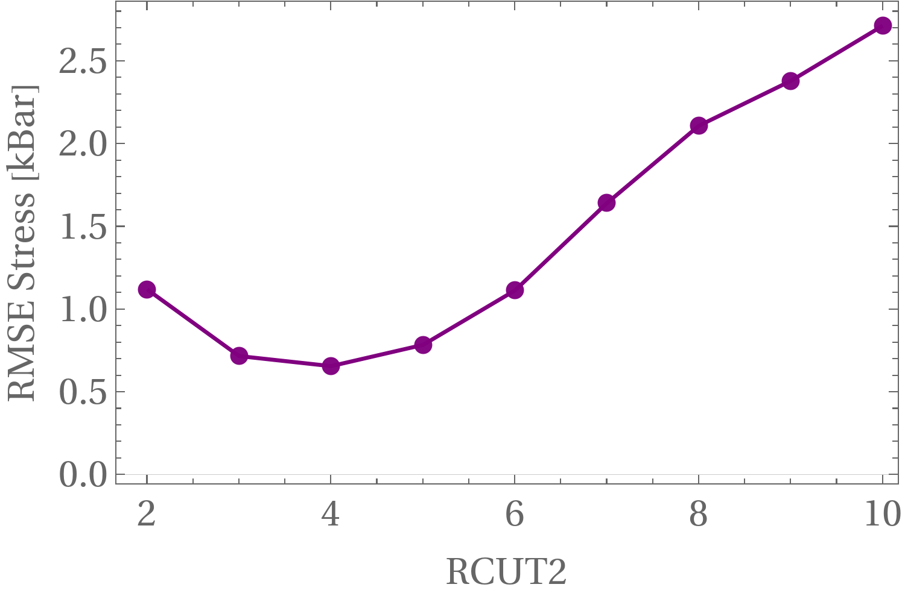
Reffiting our MLFF: RCUT2
Methodology
RCUT2 provide a clear minimum for each three error models. For the RMSE Energy & Force, a minimum is located at 3. However, for RMSE Stress, the minimum is 4.

Slide 14
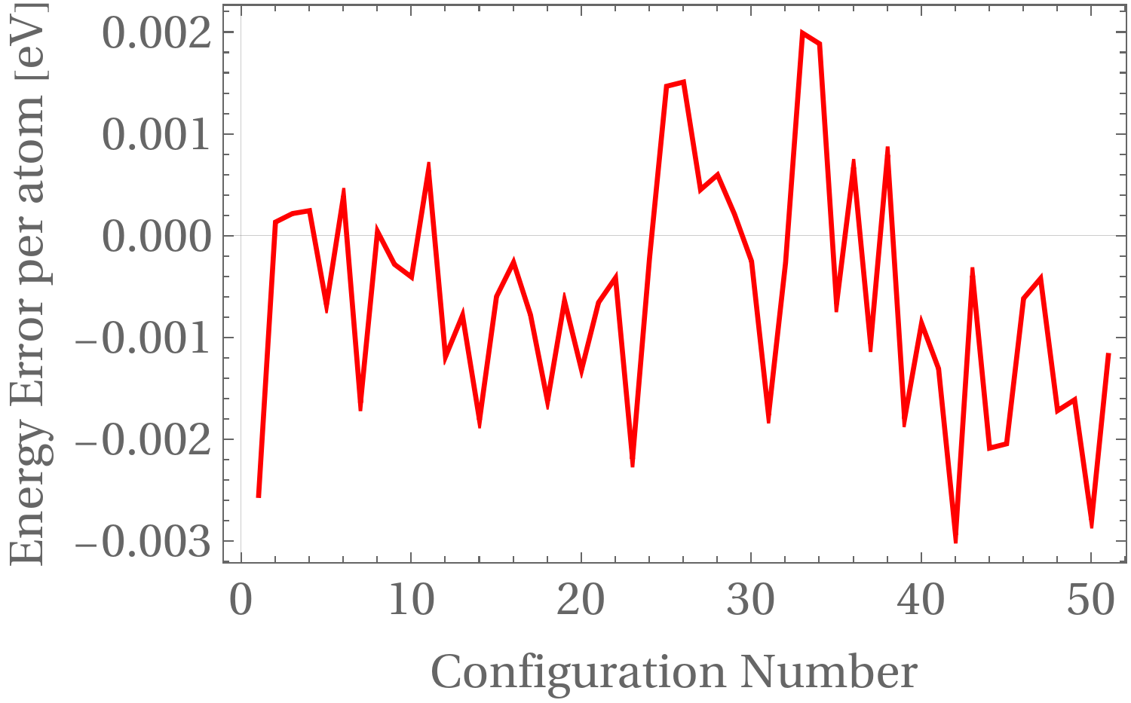
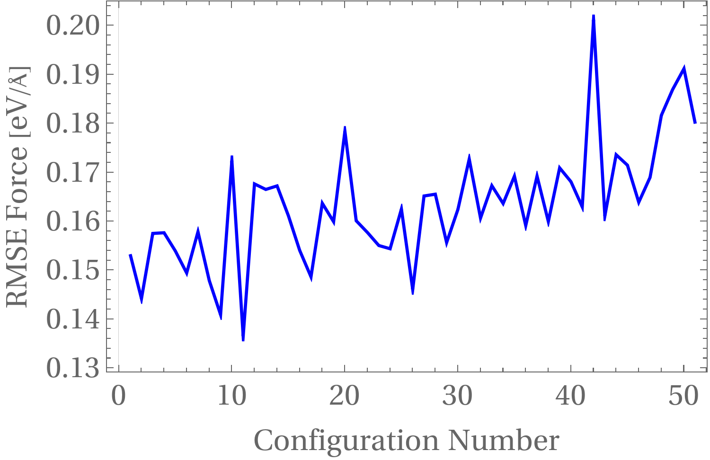
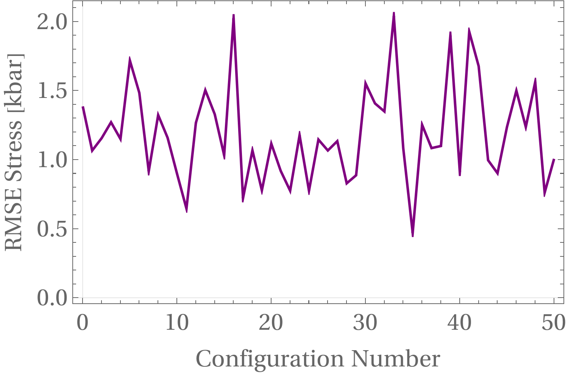
Error analyis (Reffited model)
Methodology
After refitting our MLFF with RCUT1=17 & RCUT2=3, we computed the prediction errors once more, and noticed a significant reduction in the energy and force erros, while stress erros do not change too much.

Slide 15
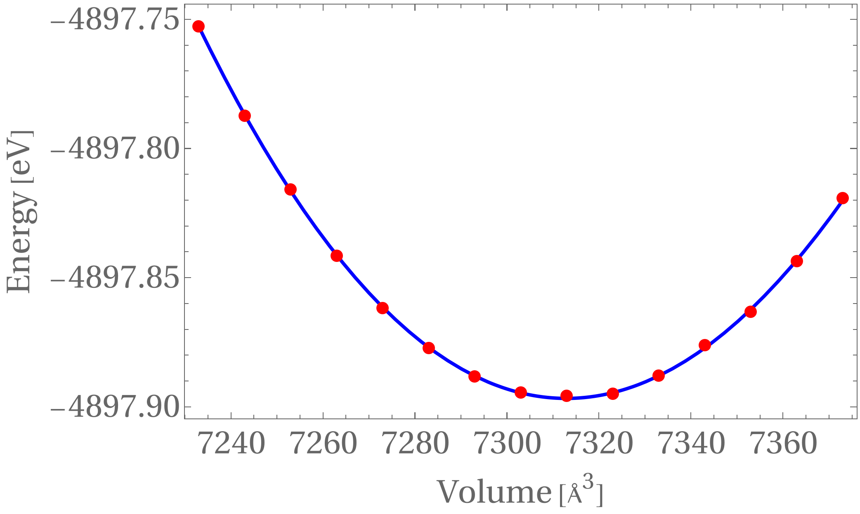
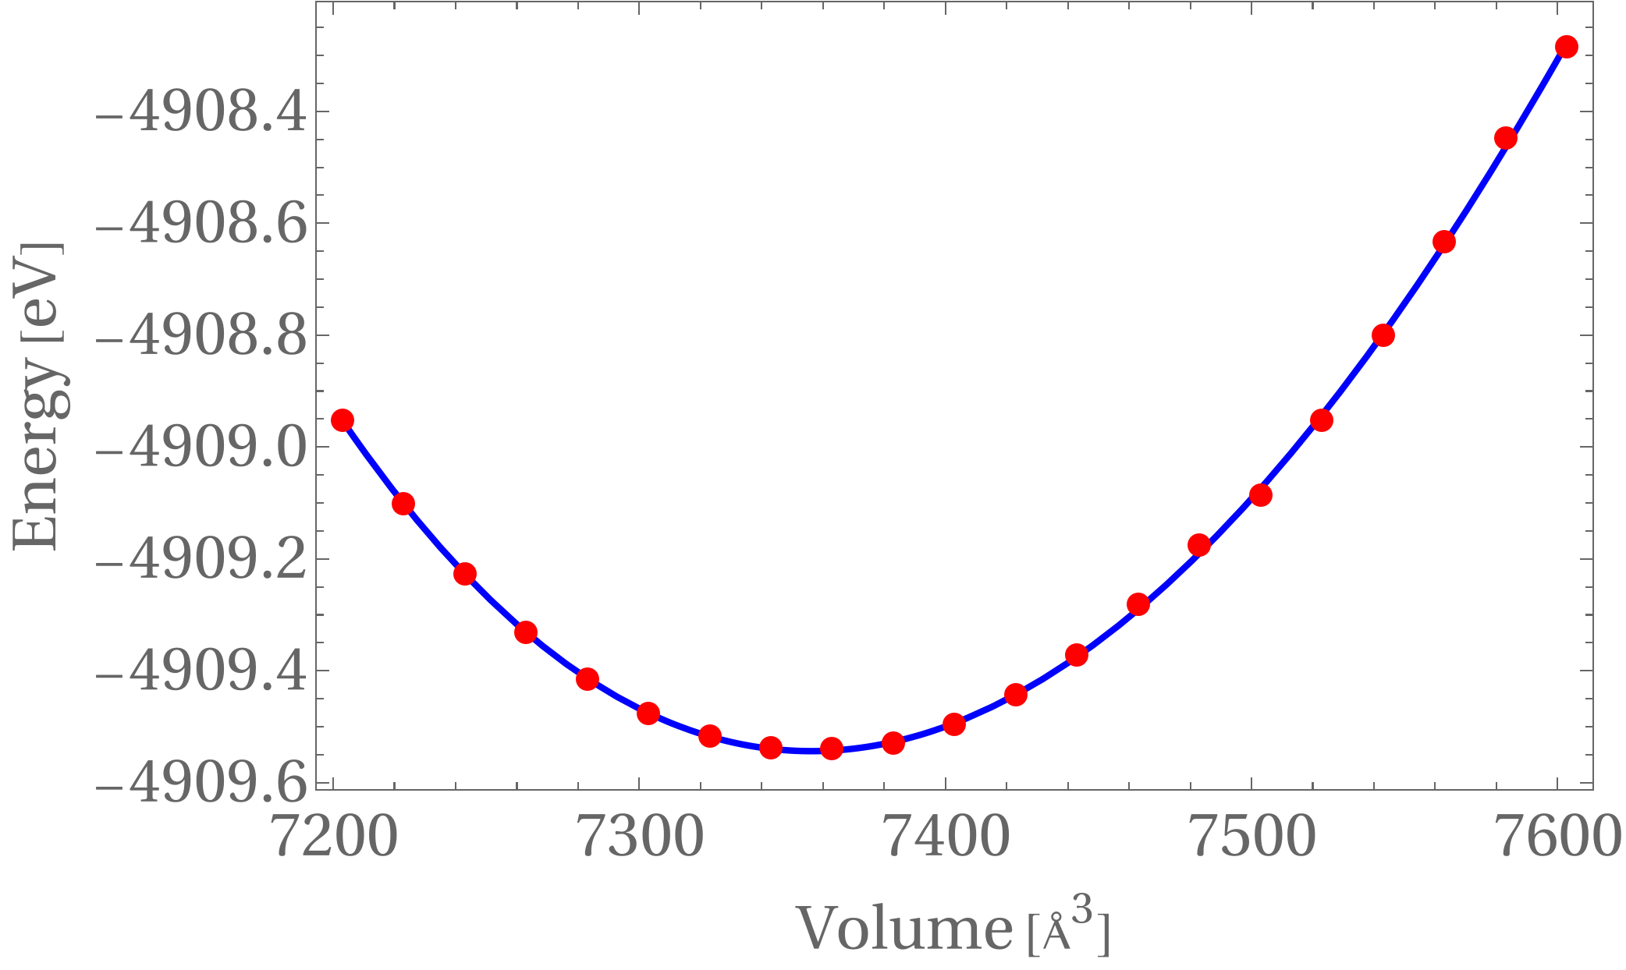
Equation of State (EOS)
Methodology
Here we compare two EOS models for CSH. The first one was computed using our refitted model, varying the cell volume and relaxing the structure. On the other hand, the second model was achieved by a process of simulated annealing, where we let our structure cool down from its current temperature (around 400 K) unitl it reached 0 K (approximately) using our original MLFF.
Refitted MLFF need to be revised for problems in convergence in simulated annealing.

